Slide 1
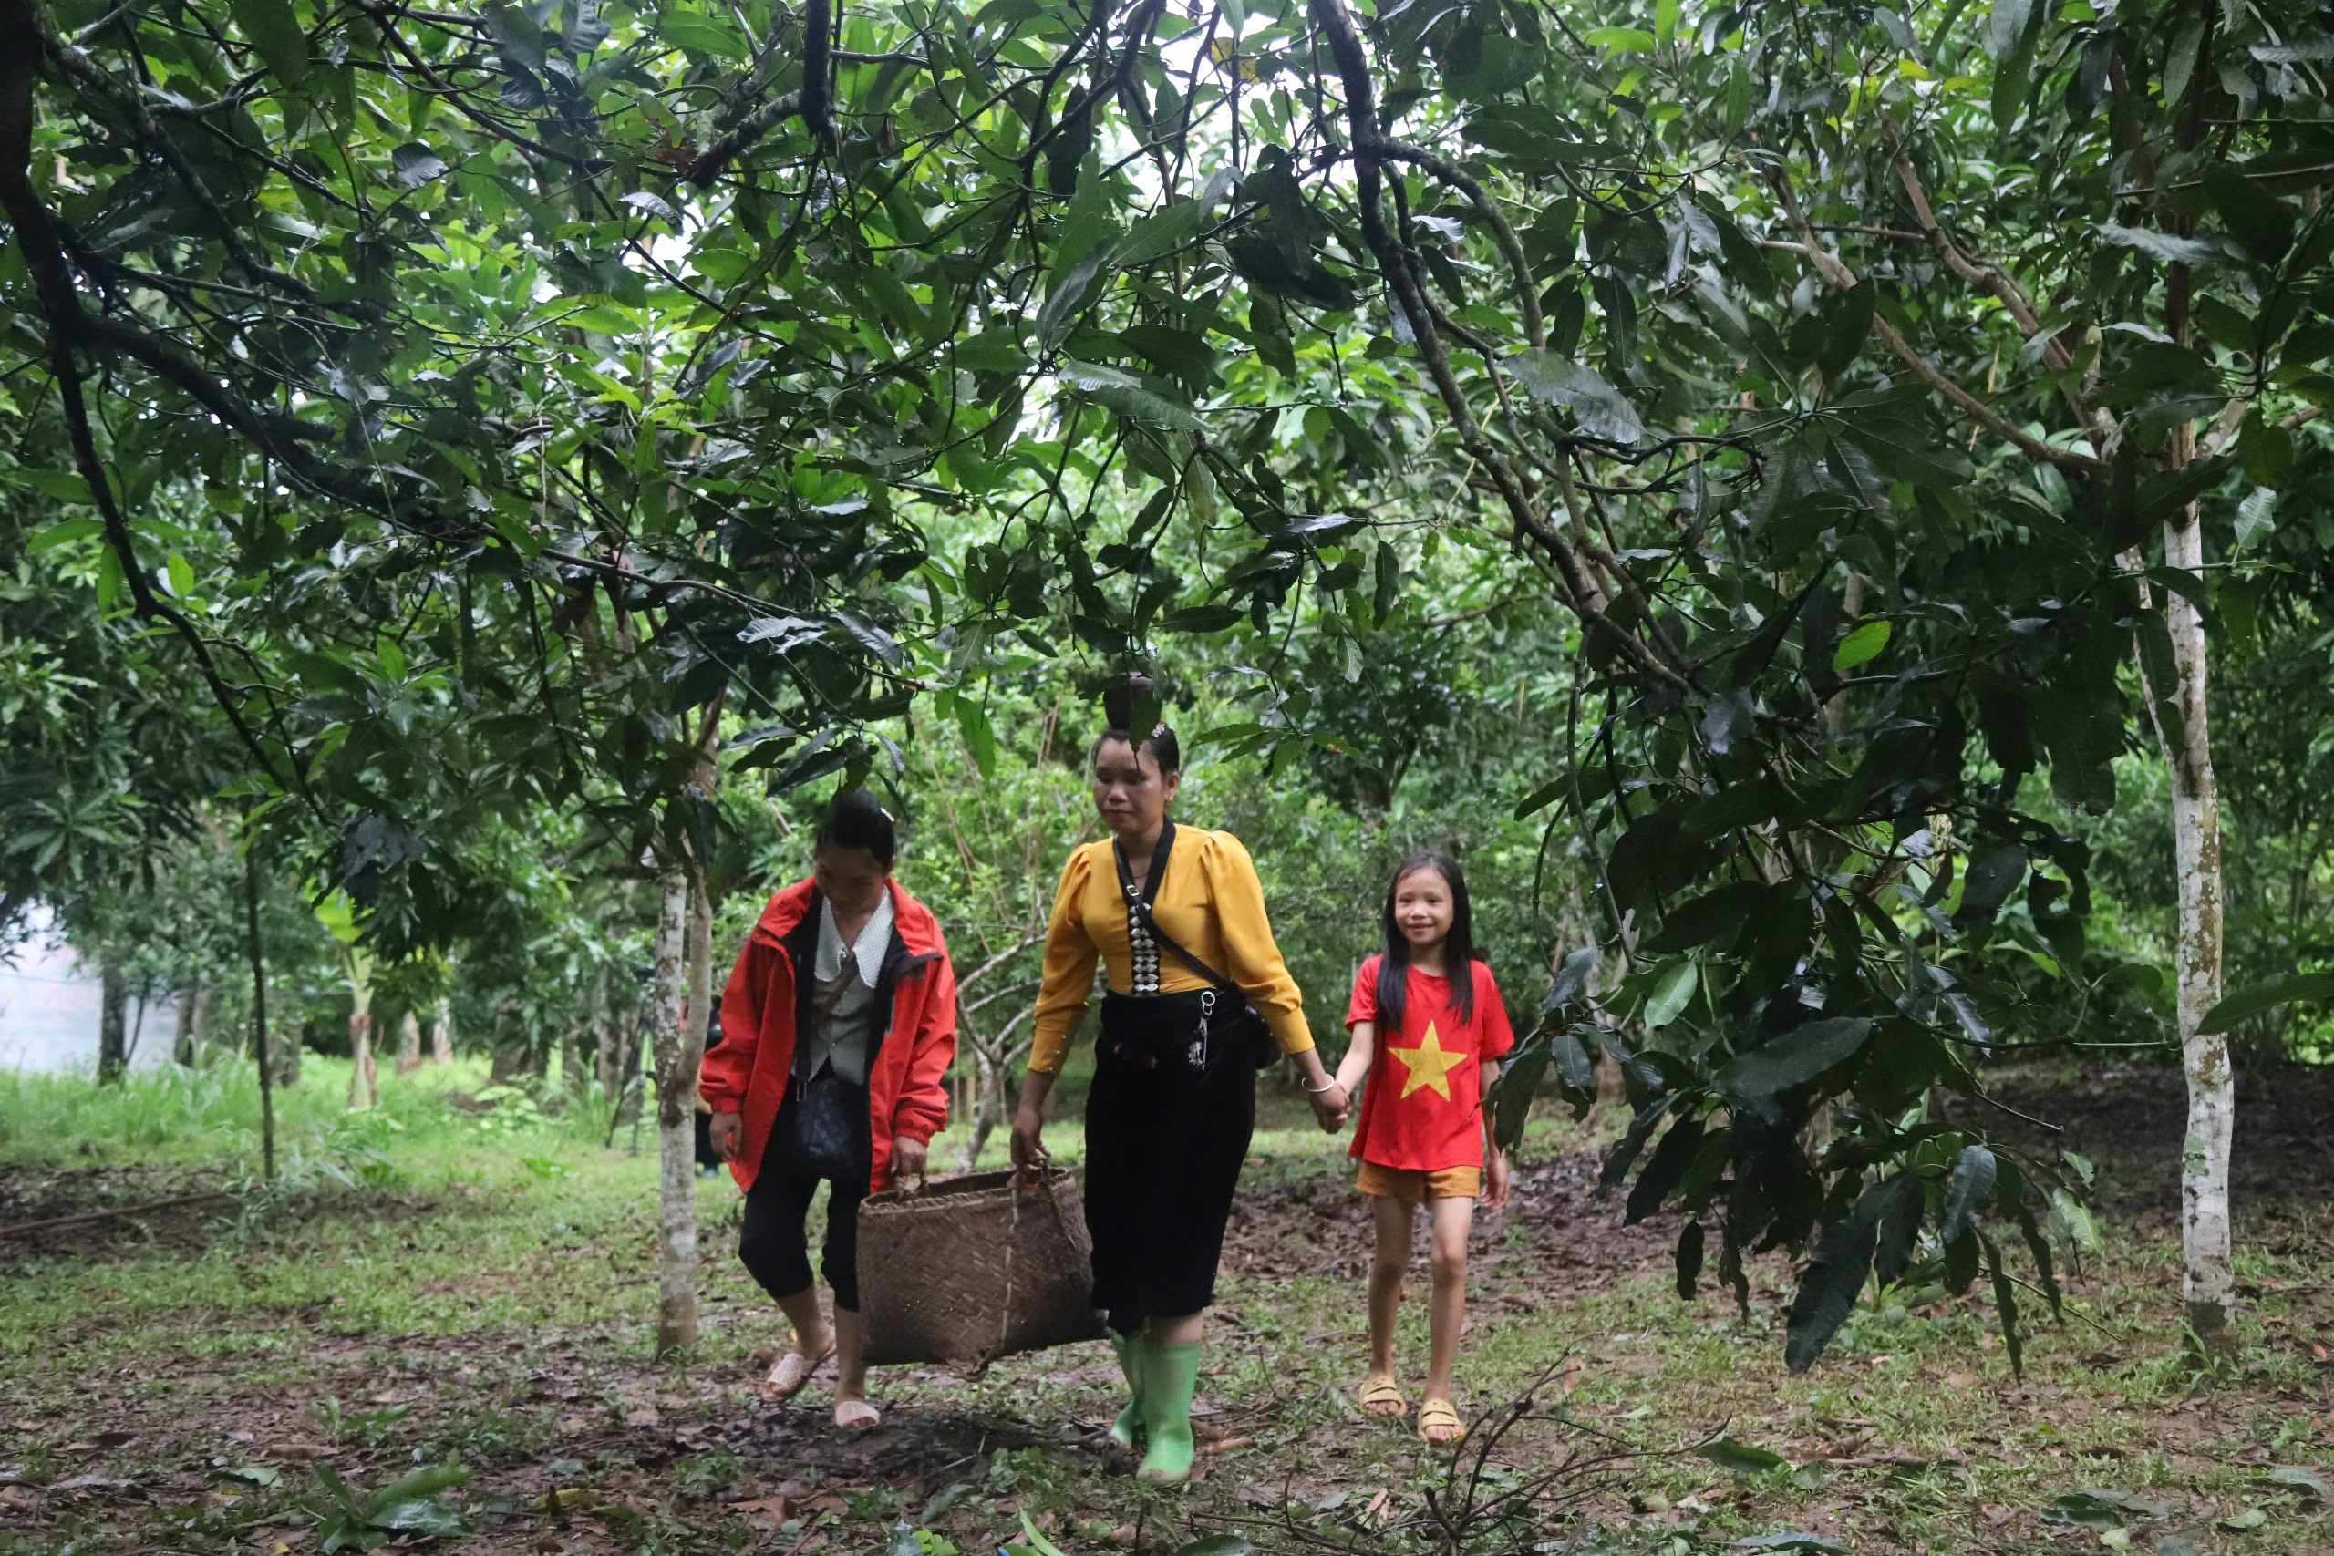
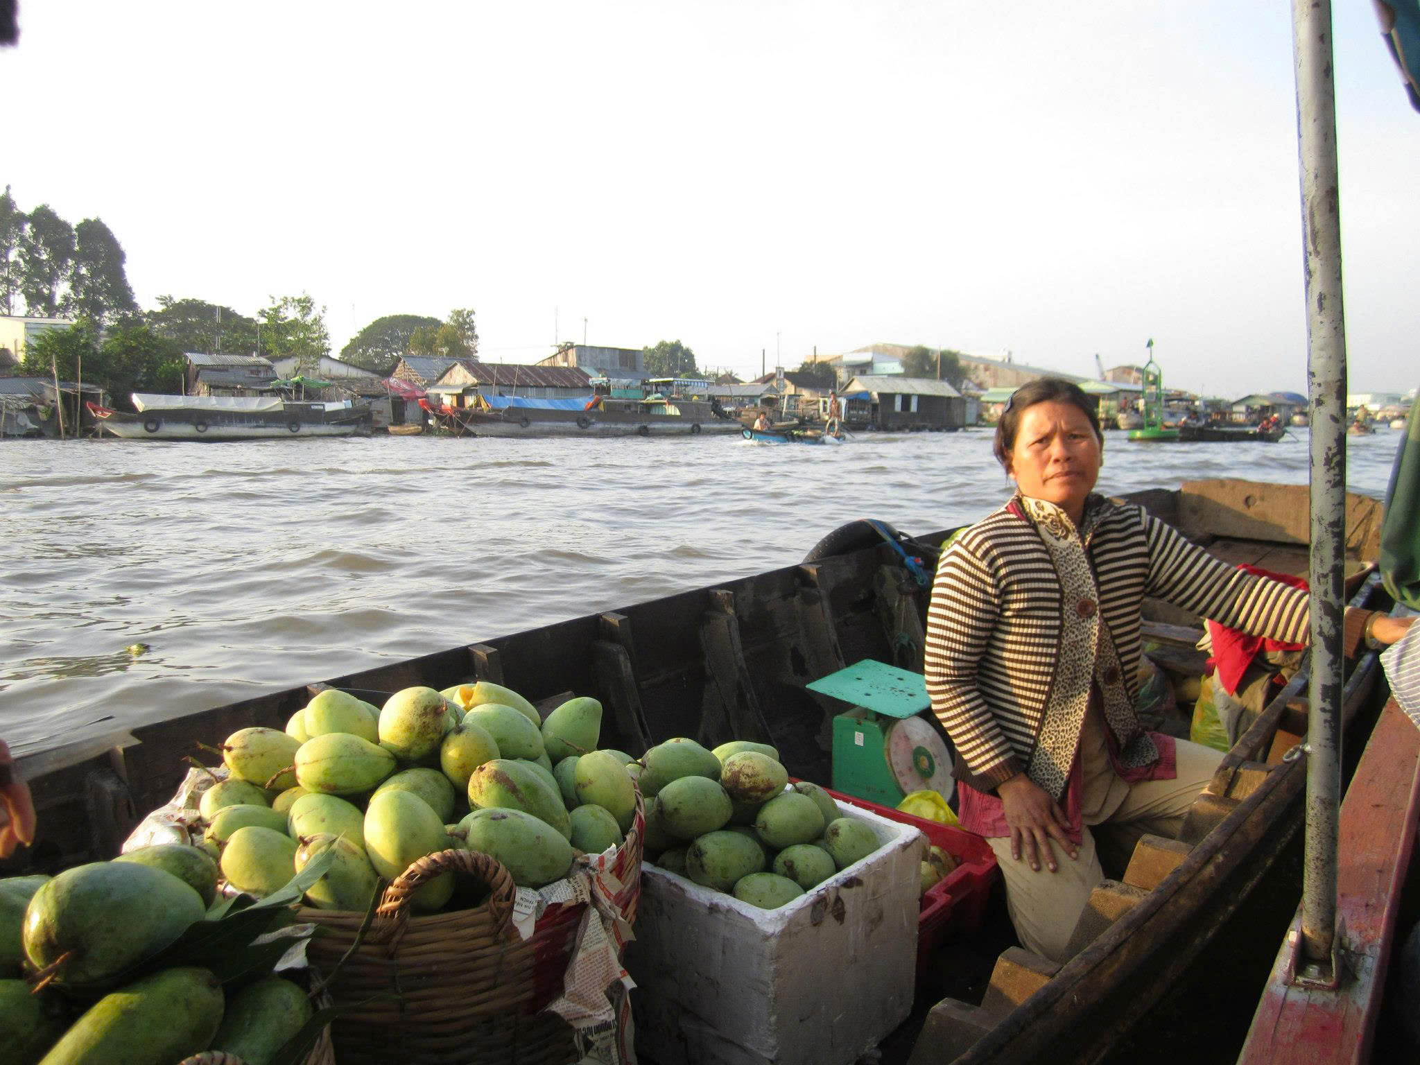
Food Resilience Seminar: Scaling Innovative Solutions to Ensure Food Resilience and Autonomy in the Asia-Pacific
Enhancing resilience of food systems in Viet Nam
How implementing the National Action Plan on Food Systems Transformation (NAP-FST) can contribute
Dao The Anh
Huynh Thi Thanh Tuyen
Nguyen Minh Quoc

Slide 2
What is food system resilience?
A resilient food system can…
FOOD SYSTEM RESILIENCE
The capacity over time of a food system and its actors to keep providing sufficient, appropriate and accessible food to all, in the face of shocks and stresses (Tendall et al., 2015; FAO, 2021)
1
Resist and absorb
Withstand shocks through buffers, stocks, diversity and redundancy
2
Adapt and recover
Adjust practices, markets and policies, and bounce back
Actor view: the ability of food system actors to maintain, protect or recover its key functions despite shocks (Béné et al., 2023)
3
Transform
Change the system when it is untenable: bounce forward, more fairly
Note: Resilience is not identical to sustainability; resilience emphasizes flexible responses to shocks while sustainability emphasizes stable and reasonable resource uses
Sources: Tendall et al. (2015); FAO (2021); Béné et al. (2023); HLPE (2025)
Notes:
Food system resilience (Tendall et al., 2015, Global Food Security 6, p. 19): "capacity over time of a food system and its units at multiple levels, to provide sufficient, appropriate and accessible food to all, in the face of various and even unforeseen disturbances".
FAO (2021, State of Food and Agriculture, p. 6) uses almost the same wording for agrifood systems and adds the livelihoods of the actors in them.
Actor view: the ability of individual and institutional actors to "maintain, protect, or successfully recover the key functions" of the food system despite shocks (Béné et al., 2023, p. 1438).
A resilient food system can: resist and absorb shocks (robustness, buffers, redundancy); adapt and recover (adjust practices, markets and policies; bounce back); and transform when the old system is untenable, to "bounce forward" in equitable ways (HLPE, 2025).
Resilience is not the same as sustainability: sustainability is about keeping the system going in the long run; resilience is about coping with disturbances along the way. The newer HLPE framing asks resilience to reduce inequality, not just restore the pre-shock state.

Slide 3
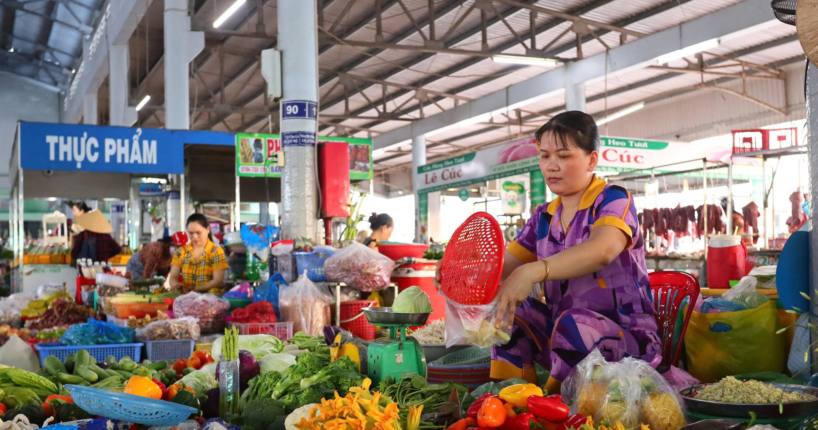
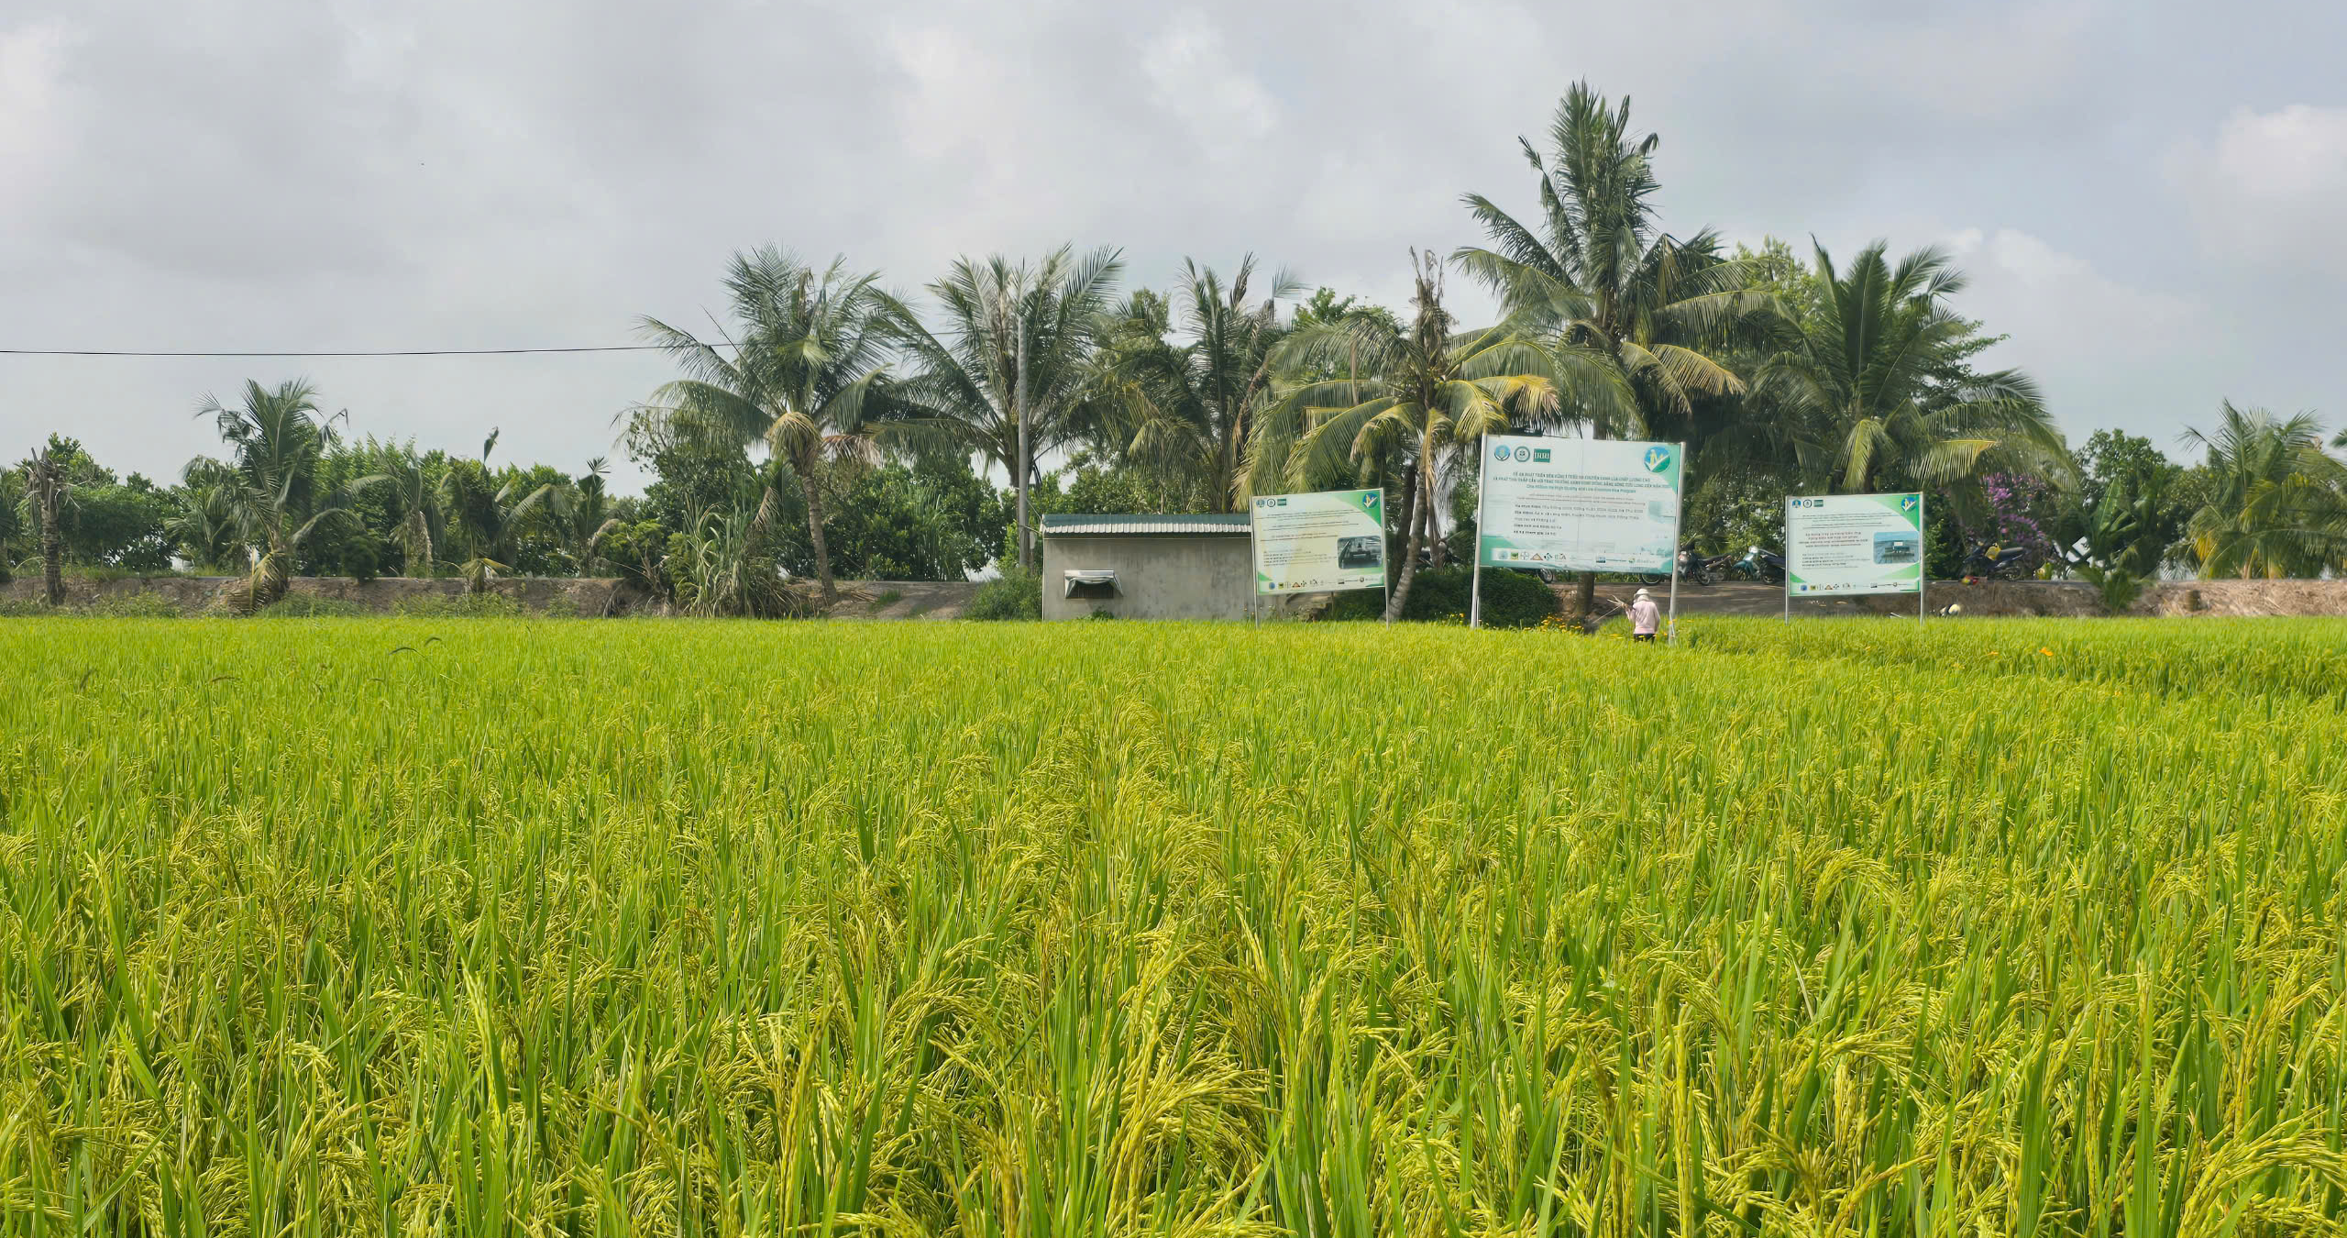

Unpacking resilience in Viet Nam
Resilience of what?
Resilience to what?
Resilience for whom?
Food security and exports
Smallholder livelihoods
Diets and nutrition
Territorial agri-food landscape
Typhoons, floods, drought
Salinity in the Mekong Delta
Price shocks (e.g., 2007–08)
Diseases (e.g, COVID-19)
Long-term stresses: land degradation, migration, pollution
Smallholders in rural areas
Ethnic minority population
Coastal and mountainous communities
Low-income urban households
Women, youth, elderly, people with disability
Sources: Hoang (2018); Nguyen et al. (2019); Bruckert & Nguyen (2024); Dawe & Slayton (2011)
Notes:
Resilience of what? Rice-based national food security and exports; smallholder and household livelihoods; diets and nutrition; territorial food systems (Mekong Delta, northern uplands).
Resilience to what? Climate: typhoons (Yagi, 2024), floods, drought, salinity intrusion in the Mekong Delta. Markets: rice and input price shocks (2007-08). Pandemics: COVID-19 (2020-21). Long-term stresses: land degradation, urbanisation, the nutrition transition.
For whom? Smallholders, ethnic minority and mountain communities, low-income urban households, women, workers along the value chain.
Evidence from Viet Nam:
- Price and income shocks push poor households towards rice at the expense of diverse diets (Hoang, 2018).
- Mekong Delta farming systems facing salinity: recovery depends on credit, off-farm income and fresh water; rice-oriented policy makes it harder to switch systems (Nguyen et al., 2019).
- Moc Chau (Son La) under COVID-19: diverse food sources, decentralised flows and low reliance on external inputs kept the local food system working (Bruckert & Nguyen, 2024).
- 2007-08 rice crisis: export restrictions, Viet Nam's among them, helped turn an adequately supplied market into a price spike (Dawe & Slayton, 2011).
Key message: diversity, finance and sound policy decide who copes. Most evidence is household- or farming-system-level; there is no national resilience assessment for Viet Nam yet.

Slide 4
How to build resilient food systems?
Adapted from Biggs et al. (2012) and Wood et al. (2023), with critical examples from Viet Nam
1
Keep diversity and redundancy
2
Manage connectivity
3
Watch slow variables
+
In Moc Chau, a mix of food sources and decentralised supply routes meant that when one channel failed during COVID-19, others kept food reaching households.
–
In 2007–08, several exporters, Viet Nam included, banned rice exports. Tightly linked markets passed the shock on, turning ample global supply into a price spike.
–
Salinity in the Mekong Delta is rising slowly, while policy built around rice makes it harder for farmers to shift to systems suited to saltier conditions.
4
Learn and experiment
5
Broaden participation
6
Share governance
+
Son La and Dong Thap built food system profiles and ran pilots first, so each provincial plan could draw on what had been tested locally.
–
In Ca Mau, resource policies built on state control, with little input from local users, did not make households more resilient.
+
The NAP-FST connects ministries, provinces and the FST-Partnership in one framework, but thin local funding limits what provinces can deliver.
Sources: Biggs et al. (2012); Wood et al. (2023); Bruckert & Nguyen (2024); Dawe & Slayton (2011); Nguyen et al. (2019); Lundy et al. (2026); Tran (2012); MAE (2025)
Notes:
Seven generic principles for enhancing resilience (Biggs et al., 2012, Annual Review of Environment and Resources 37): (P1) maintain diversity and redundancy, (P2) manage connectivity, (P3) manage slow variables and feedbacks, (P4) foster an understanding of social-ecological systems as complex adaptive systems, (P5) encourage learning and experimentation, (P6) broaden participation, (P7) promote polycentric governance. On the slide, P4 and P5 are combined. The principles often co-occur and depend on each other.
Viet Nam examples (critical reading):
1. Diversity and redundancy (+): in Moc Chau (Son La), diverse food sources, decentralised flows and low reliance on external inputs kept the local food system working during COVID-19 (Bruckert & Nguyen, 2024). Hertel et al. (2021) call diversification the most fundamental lever.
2. Connectivity (-): connectivity can spread or dampen shocks. In 2007-08, export restrictions by major exporters, Viet Nam among them, helped turn an adequately supplied rice market into a price spike (Dawe & Slayton, 2011).
3. Slow variables (-): in the coastal Mekong Delta, rising salinity is a slow stress; farmers' recovery depends on credit, off-farm income and fresh water, and rice-oriented policy makes it harder to change systems (Nguyen et al., 2019). Land degradation in Moc Chau is another slow variable.
4. Learning and experimentation (+): Son La and Dong Thap piloted provincial food system profiles and priority-setting before a provincial plan was approved (Son La 161/KH-UBND, 2025) (Lundy et al., 2026).
5. Participation (-): in Ca Mau, shrimp-mangrove and fisheries policies aimed at social-ecological resilience did not necessarily raise households' social and economic resilience; control and enforcement alone are not enough (Tran, 2012).
6. Polycentric governance (+, with a caveat): NAP-FST links national ministries, provinces and the FST-Partnership, but most localities still lack dedicated funding and staff (MAE, 2025).
Key message: the principles help, but they can pull against each other (e.g. trade connectivity vs self-sufficiency), so trade-offs have to be negotiated (Zurek et al., 2022).

Slide 5


Policies towards food systems transformation in Vietnam
2002–2008: Resolutions 15-NQ/TW and 26-NQ/TW – Improving quality and developing value chains
Before 1986: Centrally planned economy
1988: Resolution 10-NQ/TW (Contract 10) – Output breakthrough
2013: Decision 899/QĐ-TTg on agricultural restructuring – Focus on raising added value and sustainable development
2021: National Green Growth Strategy (Decision 1658/QĐ-TTg) and commitment to transparent, responsible and sustainable food systems transformation
2022: Resolution 19-NQ/TW – Shift toward multi-value agriculture and ecological agriculture
2023: National Action Plan for Food Systems Transformation towards Transparency, Responsibility and Sustainability in Vietnam until 2030 (Decision 300/QĐ-TTg)
Policy focus: Output and economic value
Focus on agriculture
Notes:
Có thể bỏ slide này vì nó thuộc cấp quốc gia
Speaker points: the shift is from sector-by-sector plans (output and economic value) to one coordinated, cross-ministry plan with measurable targets. Key steps: UNFSS national dialogues (2021) led by MARD, NIN and VAAS produced the National Pathway; Strategy for Sustainable Agriculture and Rural Development 2021-2030 (Decision 150/QD-TTg, 2022); Resolution 19-NQ/TW (2022); NAP-FST (Decision 300/QD-TTg, 28 March 2023). Later: Ministry of Health implementation plan 546/KH-BYT; COP28 Emirates Declaration on Resilient Food Systems; FST-Partnership endorsed (Letter 6483/VPCP-QHQT); MARD and MONRE merged into MAE (2025); NAP-FST mid-term report due 2026.

Slide 6
NAP-FST principles and resilience
Transparency
Responsibility
Sustainability
Information for early warning and fast, fair responses to shocks
Shared roles spread risk and protect the most vulnerable
A healthy resource base lowers long-term stress and widens adaptation options
Traceability · area codes · labelling · food balance sheets · data
Input suppliers, farmers, processors, traders, consumers and the state
Agroecology · low emissions · water and land use · less loss and waste
NAP-FST viewpoint: food system transformation is linked to “resilience to shocks” (Decision 300/QĐ-TTg, 2023)
Objective by 2030: food and nutrition security, incomes, disaster and epidemic prevention, climate adaptation and the SDGs
Notes:
Transparency: traceability, production area codes, labelling, food balance sheets and data. Better information supports early warning and quicker, fairer responses to shocks.
Responsibility: every actor has a role: input suppliers, farmers, processors, distributors, consumers and the state. Shared responsibility spreads risk and protects the most vulnerable.
Sustainability: agroecology, low emissions, efficient use of land and water, less food loss and waste. A healthier resource base lowers long-term stress and widens adaptation options.
Explicit link in the plan: one NAP-FST viewpoint ties food system transformation to "resilience to shocks", alongside agroecology, competitiveness and the reputation of Vietnamese products (Decision 300/QD-TTg, 28 March 2023).
Overall objective: food and nutrition security, better incomes and quality of life, disaster and epidemic prevention, climate adaptation, and the SDGs by 2030.
Speaker point: the three principles map onto the resilience capacities on slide 1: information and buffers help a system resist; shared responsibility helps it recover; sustainability helps it adapt and transform.

Slide 7
How NAP-FST implementation builds resilience
Policies and standards
Agroecology policy, zoning, PPP logistics, M&E
2030 targets
1
<5%
households with moderate or severe food insecurity
2
Input supply
Climate-tolerant varieties, bio-inputs, wholesale hubs
3
Production
Early warning to commune level, insurance, One Health
<15%
stunting in children under 5
4
Processing and distribution
Storage for disruptions, stable chains, less loss
−10%
food system greenhouse gas emissions vs 2020
5
Consumption
Food balance sheets, pilot food bank, healthy diets
Source: Decision 300/QĐ-TTg (2023), Section III and Appendix
Notes:
NAP-FST task areas and the resilience capacity they build:
- Policies and standards: agroecology and low-emission policy; planning by ecological zone; PPPs for logistics and cold chains; M&E indicators (adaptive, transformative).
- Input supply: climate-tolerant varieties; organic fertiliser and bio-pesticides; wholesale markets as logistics hubs (absorptive, adaptive).
- Production: digital weather, pest and market warnings down to commune level; agroecological protocols; nutrition-sensitive agriculture in mountain and ethnic minority areas; One Health; risk management and agricultural insurance (absorptive, adaptive).
- Processing and distribution: storage to buffer supply disruptions, prioritising the poor; stable supply chains; food loss and waste reduction; e-commerce (absorptive: redundancy and buffers).
- Consumption: national and provincial food balance sheets; a pilot food bank; healthy and responsible consumption (absorptive; protects outcomes).
2030 targets that matter for resilience: severe or moderate household food insecurity below 5%; stunting below 15%; post-harvest losses down 0.5-1% a year; GAP or equivalent above 30% of output; food system GHG emissions down 10% from 2020.
Speaker point: many NAP-FST tasks are in effect resilience measures even though they are not labelled that way. Making the resilience lens explicit would help set priorities and design monitoring.
Source: Decision 300/QD-TTg (2023), Section III and Appendix.

Slide 8
Implementing NAP-FST at national level
Institutions and policies
Monitoring and resources
Sharing and dialogue
MAE: task assignment (Decision 4812, Nov 2023); FST-Partnership with 51 partners
Ministry of Health: Plan 546/KH-BYT (Apr 2023); task assignment (Oct 2023)
Provinces: own plans; NAP-FST built into provincial programmes
M&E indicator set completed (2023–2024)
5 inter-sectoral working groups (2025): policy, agroecology, food loss and waste, nutrition, responsible consumption
Draft implementation plan (FST-PIP, 2025)
Global: FAST partnership, pioneer-country coalition, COP28, COP29
National: dialogues spreading agroecology, nutrition and climate adaptation models
How this builds resilience
Clear mandates and cross-ministry coordination → faster, joined-up responses to shocks · M&E → early signals and learning · partnerships → pooled finance, data and expertise
Sources: Decision 300/QĐ-TTg (2023); MAE overview of NAP-FST implementation; UNDP (2025)
Notes:
National implementation of NAP-FST (translated and combined from the Vietnamese slides on institutions and policies, and on M&E and resource mobilisation).
Institutions and policies: Decision 300/QD-TTg (28 March 2023) approved the National Action Plan. Ministry of Agriculture and Environment (MAE): Decision 4812/QD-BNN-HTQT (13 Nov 2023) assigning NAP-FST tasks; the Partnership Agreement on transparent, responsible and sustainable food systems transformation (FST-Partnership) with ministries, local authorities and 51 partners. Ministry of Health: Plan 546/KH-BYT (25 April 2023) implementing Decision 300 within the health sector; Official Letter 6720/BYT (19 Oct 2023) assigning tasks. Provinces: develop plans to implement Decision 300 and integrate its content and tasks into provincial plans and programmes.
M&E and resources: M&E indicator set for the Plan completed (2023-2024); 5 inter-sectoral technical working groups set up (2025): (i) policy and institutions, (ii) agroecology, (iii) food loss and waste, (iv) nutrition and local food diversification, (v) responsible distribution and consumption; draft detailed implementation plan (FST-PIP, 2025: 37 tasks); multi-stakeholder resource mobilisation and technical support.
Sharing and dialogue: active participation in global forums (FAST partnership; the coalition of pioneer countries for food systems transformation; COP28, COP29); national dialogues to spread successful models of agroecology, nutrition improvement and climate adaptation.
2026 priorities (from the earlier timeline slide): strengthen capacity at central and local levels (training, M&E); support two pilot provinces (Son La with ADB, Dong Thap with VN Adapt); mobilise resources; stocktaking by FS partners; develop an implementation programme; mid-term report.
How this builds resilience: clear mandates and cross-ministry coordination mean faster, joined-up responses when shocks hit; M&E gives early signals and lessons; partnerships pool finance, data and expertise; working groups on agroecology, nutrition and food loss target the buffers that protect food security.

Slide 9
Sub-national pilots: the FSDS process in Sơn La
Pilots in Sơn La and Đồng Tháp · FSDS = Food Systems Transformation Decision Support
Leverage points for resilience
1
Jun 2024
2
Sep 2024
3
Oct–Nov 2024
4
Nov 2024
Agroecology
Kick-off and provincial working group
Food system training
Food system profile
Priority issues identified
Diverse farms, fewer bought inputs and healthier soils buffer price and climate shocks; in Moc Chau they kept food moving through the pandemic
5
Jan–Jul 2025
6
Sep 2025–Jul 2026
7
2026
Result
Plan 161/KH-UBND, 29 Jul 2025
Provincial implementation plan
Multi-sector investment plan
Documenting the process
Healthy diets
Photo: FSDS workshop in Sơn La
Shocks push poor households onto rice alone; demand for diverse local foods and nutrition-sensitive programmes protect them
Sources: Sơn La Plan 161/KH-UBND (2025); Lundy et al. (2026); Bruckert & Nguyen (2024); Hoang (2018)
Notes:
Sub-national pilots (translated from the Vietnamese slide): pilots in Son La and Dong Thap. The Food Systems Transformation Decision Support process (FSDS) in Son La:
2024: kick-off meeting and set-up of the provincial technical working group (June 2024); training on food systems (Sept 2024); food system profile (Oct-Nov 2024); identifying priority food system issues (Nov 2024); sharing lessons among partners.
2025-2026: support for the provincial implementation plan (Jan-Jul 2025); support for a multi-sector investment plan (Sept 2025 - Jul 2026); documenting the process (Jan-Dec 2026).
Result: Son La's provincial plan for food systems transformation was issued as Plan 161/KH-UBND on 29 July 2025, implementing Decision 300/QD-TTg.
Leverage points for resilience:
- Agroecology: diverse farms with fewer purchased inputs and healthier soils are less exposed to input-price and climate shocks. In Moc Chau (Son La), diverse food sources, decentralised flows and low reliance on external inputs kept the local food system working during COVID-19 (Bruckert & Nguyen, 2024). Son La links agroecology with tourism.
- Healthy diets: after price and income shocks, poor households shift to rice at the expense of other foods (Hoang, 2018). Demand for diverse local foods supports diverse production, and nutrition-sensitive programmes (an NAP-FST task for mountainous and ethnic minority areas) protect the most vulnerable. NAP-FST 2030 targets: stunting below 15%, overweight and obesity below 20% in adults.
Speaker point: provinces are where resilience is built, because shocks are local; agroecology and healthy diets give provinces concrete entry points that serve both transformation and resilience.

Slide 10
Platforms for multi-stakeholder action
FST-Partnership
ALiSEA
51
partners
~200
members
Government-endorsed, chaired by MAE · 5 technical working groups · finance, knowledge and capacity
Agroecology network in 5 Mekong countries · knowledge sharing, policy dialogue, small grants
Photo
Why it matters: platforms connect agriculture, health, trade and environment, share early information and coordinate responses to shocks
Sources: Lundy et al. (2026); UNDP (2025); ALiSEA (ali-sea.org)
Notes:
FST-Partnership: a government-endorsed platform (Letter 6483/VPCP-QHQT) chaired by MAE, signed by 3 ministries and 30 partners; it now engages 51 partners (MAE overview of NAP-FST implementation; earlier counts: UNDP 47 in June 2025, Alliance report 49+). Members include government, UN agencies (FAO, UNDP and others), development partners, research organisations (CGIAR and others), NGOs and businesses. Focus: strategic partnerships, finance for agriculture, knowledge and capacity building, and 5 technical working groups.
ALiSEA (Agroecology Learning Alliance in South East Asia): a regional agroecology network in Cambodia, Laos, Myanmar, Thailand and Viet Nam with about 200 members (NGOs, farmer organisations, research, private sector and government). It works on knowledge sharing, awareness, policy dialogue, capacity building and small grants, and links agroecology practice with policy, including the consultation on ASEAN guidelines on agroecology policy (Nov 2025) [check the guideline's name].
Why platforms matter for resilience: they connect sectors that otherwise work separately (agriculture, health, trade, environment), share early information, pool resources and coordinate responses when shocks hit. Platforms are part of the social infrastructure of resilience: connectivity, trust and coordination.

Slide 11
What should be done next?
1
Sustainable, low-emission production
2
Food safety, consumption, less waste
Low-emission crops · 1 million ha high-quality, low-emission rice (Mekong Delta) · agroecology, circular agriculture, nature-based solutions
Standards, quality, traceability and information · responsible consumption · less food loss and waste
Resilience: Diversity and healthy soils cut climate and price risks
Resilience: Trust and information keep markets working in a crisis
3
Disaster risk reduction
4
Science, technology, digital
Monitoring, forecasting and response · risk-sharing mechanisms and insurance
Breeding, high-tech livestock, processing and preservation · digital value chains and databases
Resilience: Absorb shocks and recover faster
Resilience: Adapted varieties, early warning, traceability
Across all four: measure resilience in NAP-FST M&E · protect the most vulnerable · fund provinces · coordinate through platforms
Notes:
Priority directions for the coming period, and why each builds resilience:
1. Production: sustainable, resilient and low-emission. Emission reduction projects in crop production; the sustainable development project of one million hectares of high-quality, low-emission rice in the Mekong Delta; promoting agroecology and circular agriculture, nature-based solutions and green agriculture. Resilience: diversity and healthier soils reduce exposure to climate and input-price shocks.
2. Food safety and hygiene (reviewing regulations on product standards, quality, traceability, information dissemination); sustainable and responsible consumption; reducing food loss and waste. Resilience: trust and information keep markets working in a crisis; less loss and waste means a larger buffer.
3. Disaster risk prevention and mitigation: monitoring, forecasting, response measures, risk-sharing mechanisms and insurance. Resilience: absorb shocks and recover faster.
4. Science, technology and digital transformation: priority to breeding and hybridisation, high technology in livestock farming, processing and product preservation; digital transformation across the whole agricultural value chain; databases. Resilience: adapted varieties, early warning and traceability.
Cross-cutting, to make resilience explicit: add resilience indicators to NAP-FST M&E and the 2026 mid-term review; assess resilience nationally and by province (shocks, vulnerable groups, critical points such as wholesale markets and storage); protect the most vulnerable (shock-responsive social protection, food reserves, nutrition programmes in mountain and ethnic minority areas); fund local implementation (provincial budgets, climate and private finance); use the FST-Partnership and ALiSEA to coordinate during shocks. Aim to bounce forward: recovery should lead to fairer, greener food systems, not a return to the old ones.

Slide 12
Thank you
Acknowledgements
Notes:
Acknowledgements: add partners, funders and logos here.

